Slide 1
Computers Tools for an Information Age
Software Systems and Applications

Slide 2
Objectives
Software Systems and Applications
File Management
Files, Folders, and Paths
Anti-Virus Software
Microsoft Office
Microsoft Word
Microsoft Excel
Microsoft Outlook
Microsoft Access
Microsoft power point

Slide 3
Microsoft Office

Slide 4
Introducing Office
An office suite is:
An interconnected bundle of programs that share resources with each other.
Designed to help workers accomplish tasks they perform in an office.

Slide 5
Title Bar
Window controls– Enable the window to be maximized, minimized, restored, or closed.
The name of the application and the name of the file being worked on.

Slide 6
Menu Bar
The menu bar contains the names of pull-down menus.
Pull-down menus contain commands that can be used with the application.

Slide 7
Toolbars
The toolbars contain icons that represent the most commonly used commands.

Slide 8
Task Pane
Clipboard
Clip Organizer
A repository of clip art and images that can be inserted into a document.
Temporarily stores whatever was cut or copied from a document. They are available for use with any Office application.

Slide 9
Status Bar
Contains specific information about the activities within a program, such as current page number and the number of pages in the document.

Slide 10
Window Borders
The size of the window can be changed by dragging the vertical, horizontal, or corner borders.

Slide 11
Application Workspace
The application workspace displays the document you are working on.

Slide 12
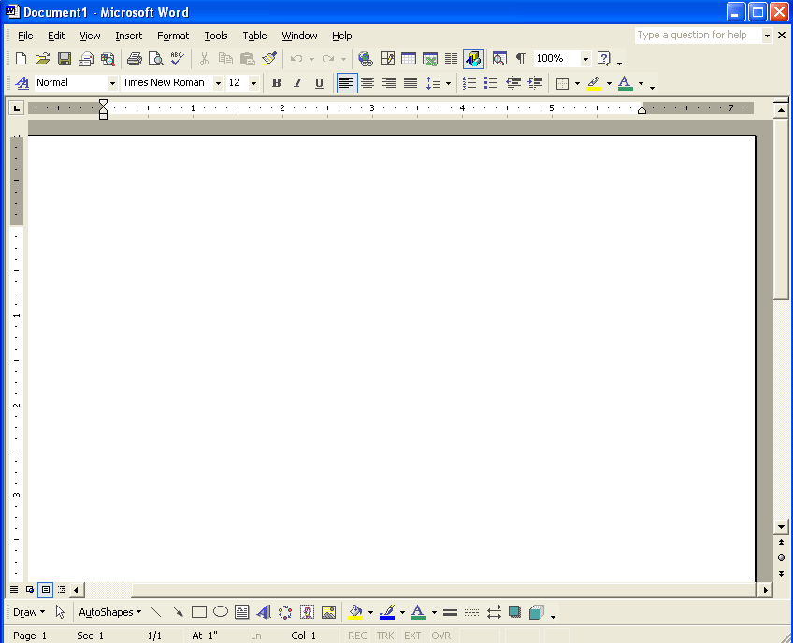
Scroll Bars, Scroll Boxes, Scroll Arrows
Scroll bars, boxes, and arrows are used to move through the document.

Slide 13
Microsoft Word
Features include:
Word processing with the power of desktop publishing.
The ability to embed charts, graphics, tables, pictures, and other objects.
Paragraph and text formatting.
The potential to use and create custom templates.
The means to link and embed documents with other Office programs.
The capability to save files as documents, plain text, templates, or Web pages.

Slide 14
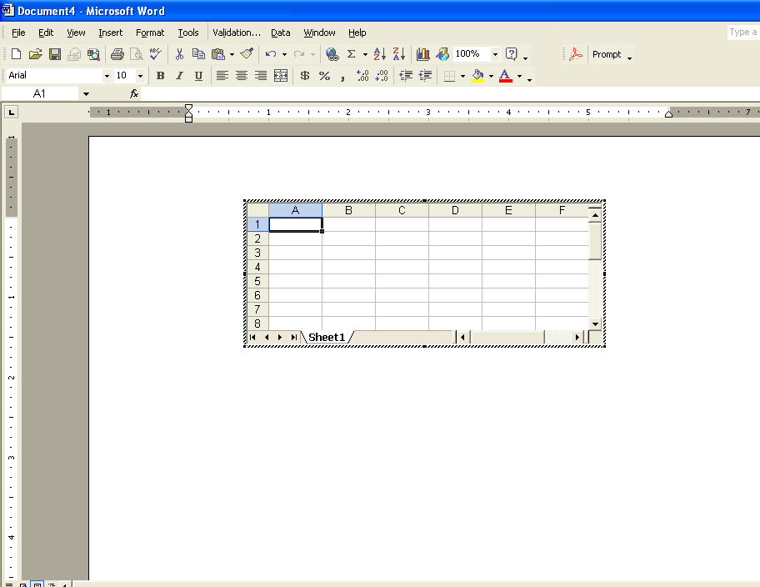
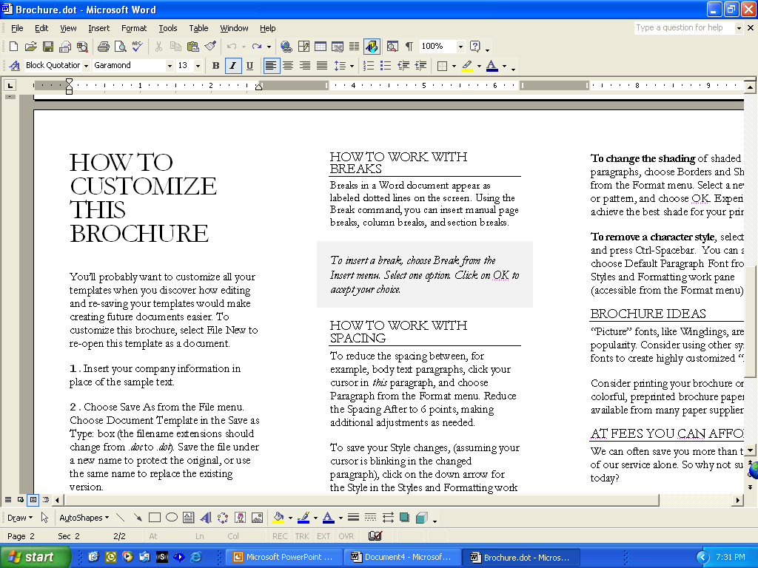
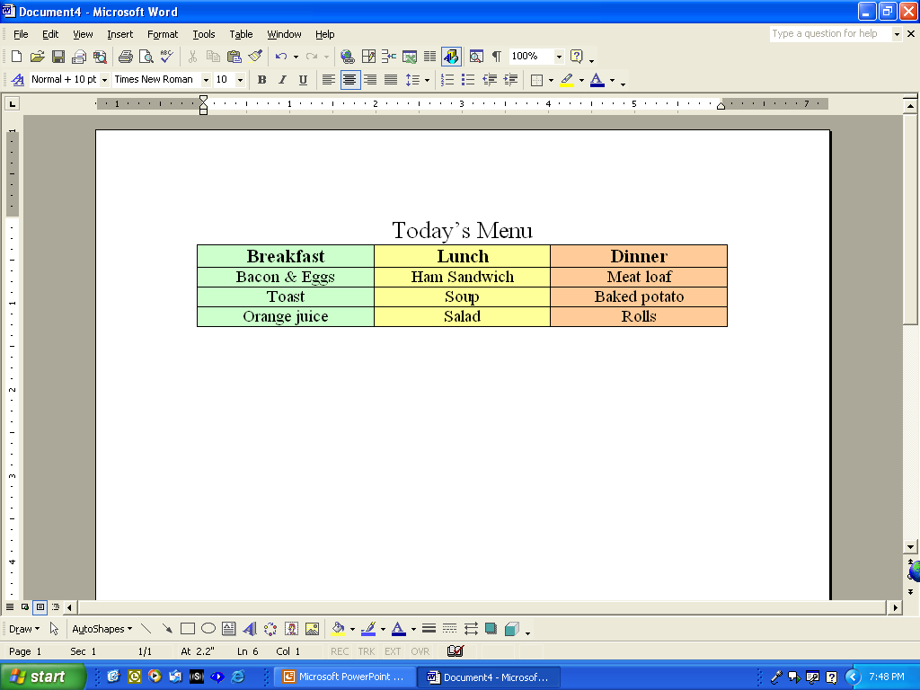
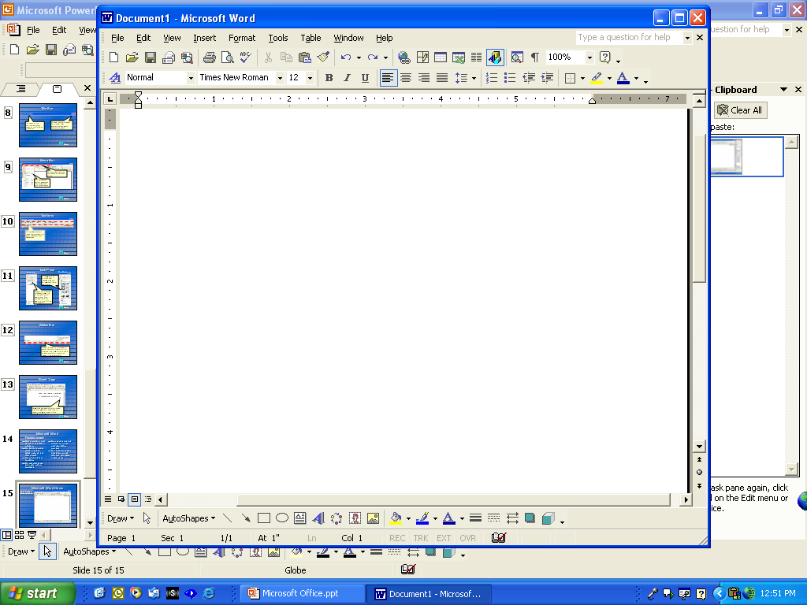
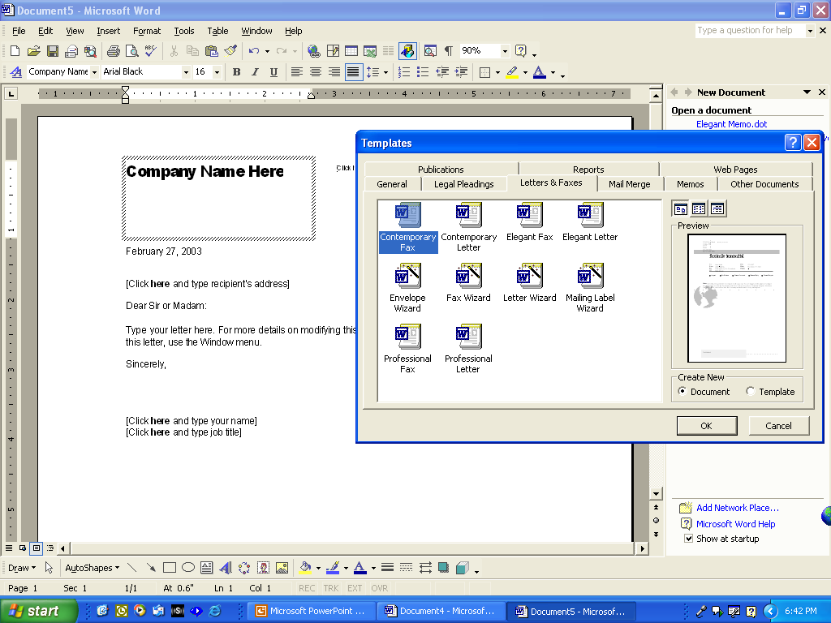
Microsoft Word Features
My Dog Sam
Use Templates
Insert Excel Spreadsheets
Create Brochures
Create Tables
Insert Graphics

Slide 15
Microsoft Excel
Excel is the most popular spreadsheet program.
Spreadsheets are designed to store and manipulate numbers.
Charts can also be created in Excel.
Each Excel file is called a workbook.
The user interface is similar to that of Microsoft Word.

Slide 16
Microsoft Excel Worksheet
The worksheet is composed of columns and rows.
The intersection of a row and column is called a cell.
Text, numbers, and formulas (functions) can be entered into cells.

Slide 17
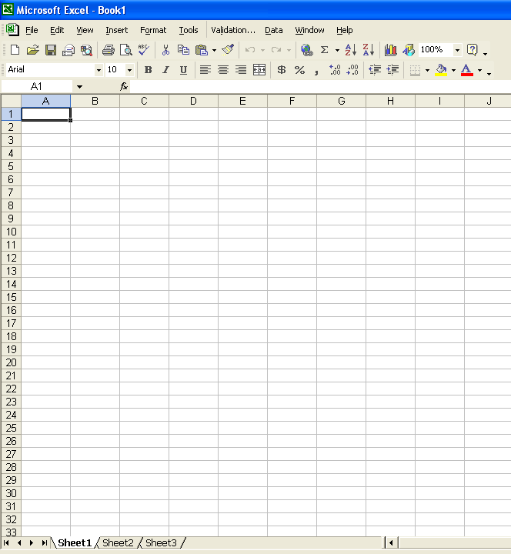
Worksheet Components
Cell
A1
Column
D
Range
G3:H6
Row
14
Worksheets
Chart

Slide 18
Microsoft Outlook
Outlook is an e-mail and organizational communications tool that can be used to:
Send and receive e-mail
Maintain a calendar
Schedule meetings
Store contact information

Slide 19
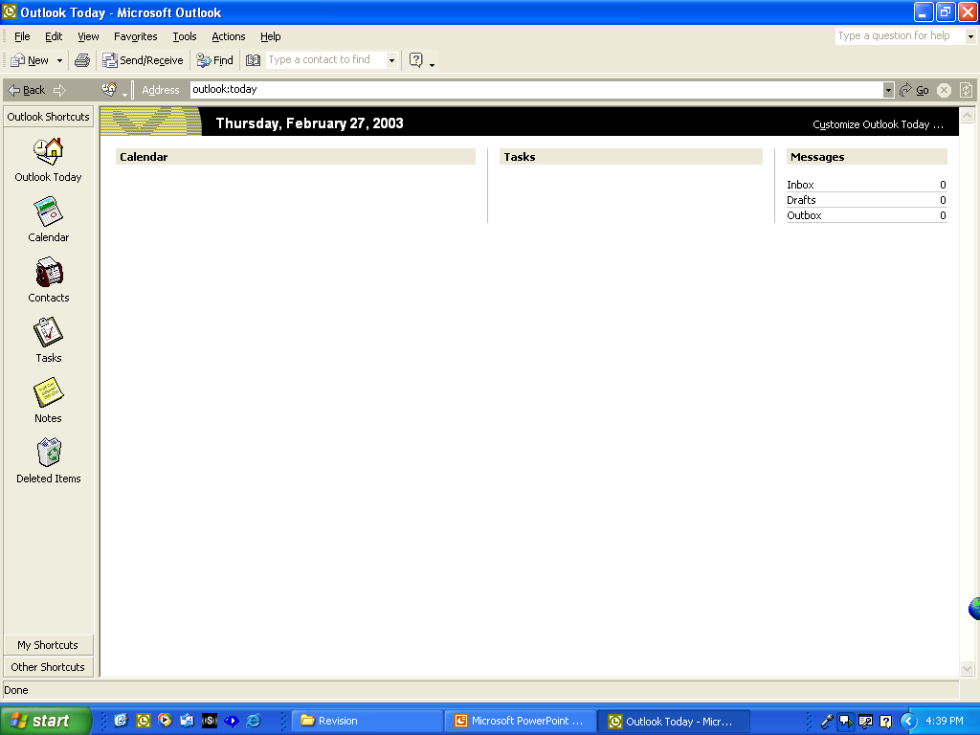
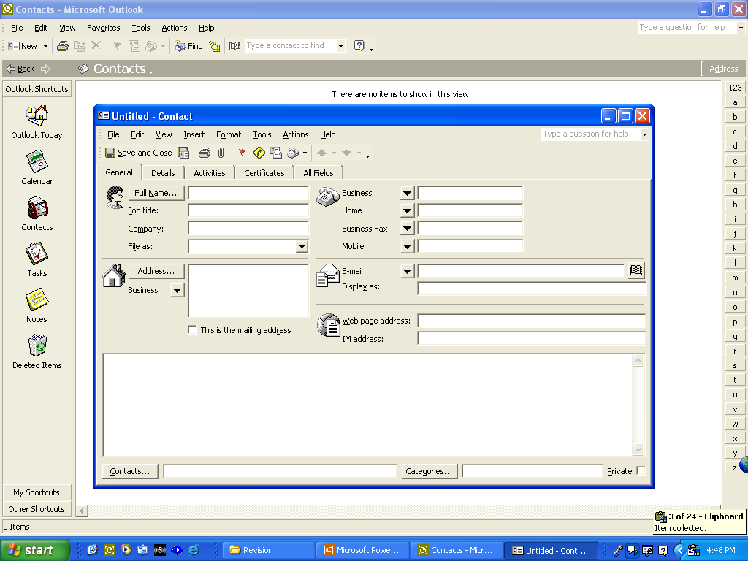
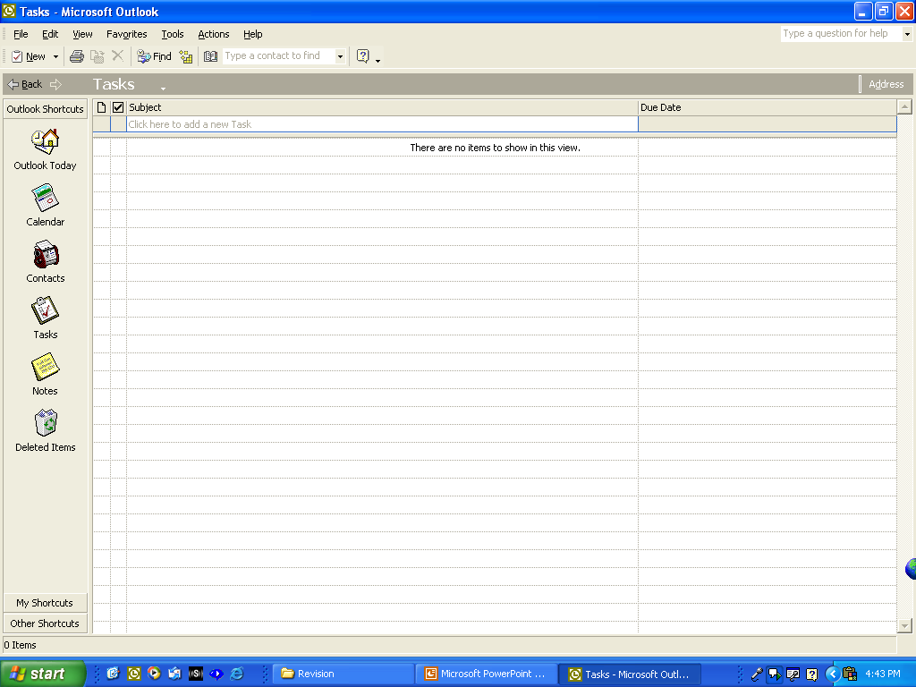
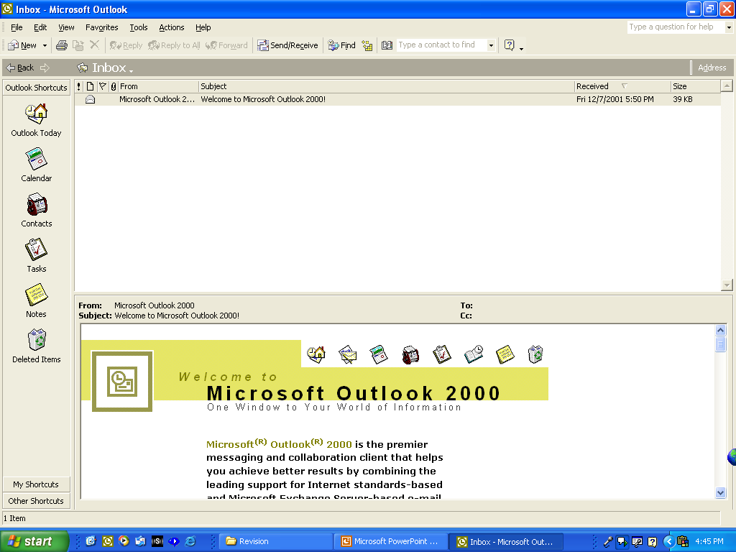
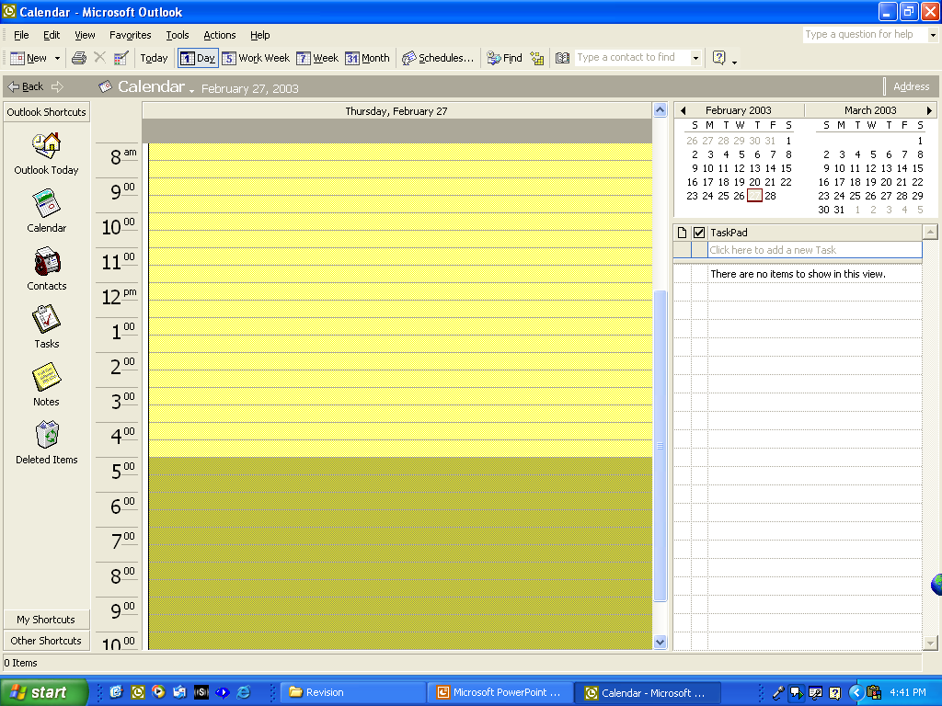
Microsoft Outlook Components
Tasks
E-mail
Calendar
Outlook Today
Contact List

Slide 20
Microsoft Access
Access is a database management system (DBMS).
Databases manage data by enabling the user to organize it in a way that it becomes useful and meaningful.
Two types of databases exist:
Flat file database
Relational database
The user interface is similar to that of Word and Excel.

Slide 21
Access Components
Objects– Used to manage and present data.
Table– Stores data.
Form– Collects data.
Query– Questions of the database.
Report– Presents data.
Data Access Page– Post data to the Web.

Slide 22
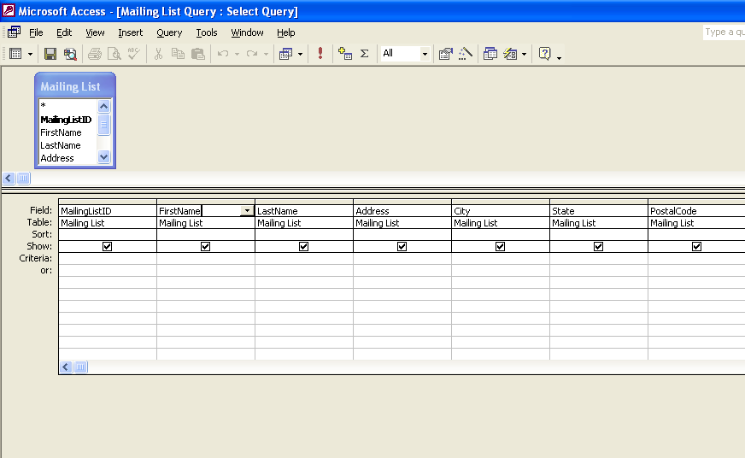
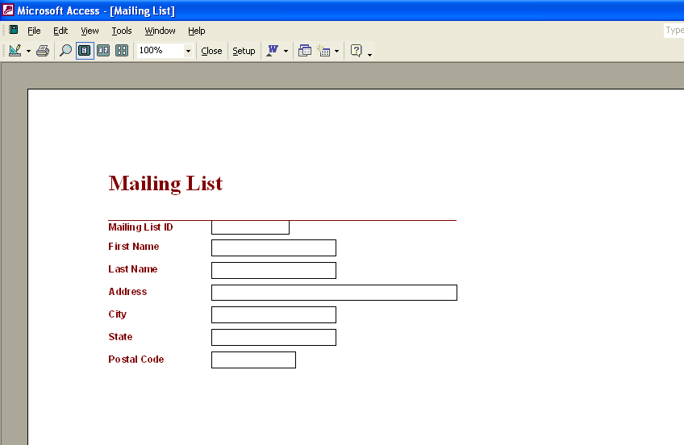
Access Interface
Click to view Object, Table, Form, Query, and Report
Report
Query
Table
Objects
Form

Slide 23
Microsoft PowerPoint
PowerPoint is used to create and deliver presentations.

Slide 24
PowerPoint Interface
Toolbars
Task Pane
Thumbnails,
Slide Sorter
Workspace

